Slide 1
PROJECT 11
Σφηναρολάκη Ελευθερία τπ4737
Γιανναδάκη Νικολέτα τπ4715

Slide 2
The purpose of this work is to first simulate data sets, control data sets on SNPs, and then analyze data and compare generated genomes. For the implementation of what we have already mentioned, we used the following tools: a)Hapgen2,b)GTOOL,c)PLINK,d)SNPTEST,e)R

Slide 3
For begin, we started with hapgen2, which simulated case control datasets at SNP markers. We chose from the hapmap offered by hapgen2 to simulate multiple disease snps on chromosome 6.With the command :
./hapgen2 -h hapmap3_r2_b36/hapmap3_r2_b36_chr6.haps -l hapmap3_r2_b36/hapmap3_r2_b36_chr6.legend -m hapmap3_r2_b36/genetic_map_chr6_combined_b36.txt -o OUTPUT -dl 2359212 1 2 2.5 -n 100 100 3 files are generated for each case and controls data types .legend, .sample files.These are the following:
HAPGEN2

Slide 4
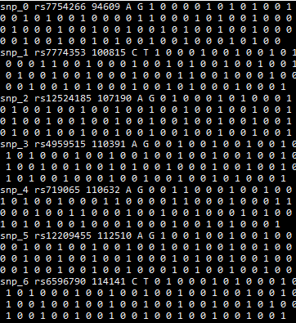
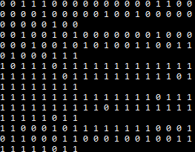
.gen
.haps

Slide 5
OUTPUT.cases.gen
OUTPUT.cases.haps
OUTPUT.cases.sample
OUTPUT.controls.gen
OUTPUT.controls.haps
OUTPUT.controls.sample
OUTPUT.legend
OUTPUT.summary and finally we have our generated data sets which we will use in our next tools.
HAPGEN2

Slide 6
Firstly , GTOOL is used to merge case and control files. ./gtool -M --g OUTPUT.cases.gen OUTPUT.controls.gen --s OUTPUT.cases.sample OUTPUT.controls.sample --og joined.gen --os joined.sample --threshold 0.9 --phenotype pheno Then it is used to convert .gen and .sample files to .ped and .map . ./gtool -G --g joined.gen --s joined.sample --ped joined.ped --map joined.map --threshold 0.9 --phenotype pheno
GTOOL

Slide 7
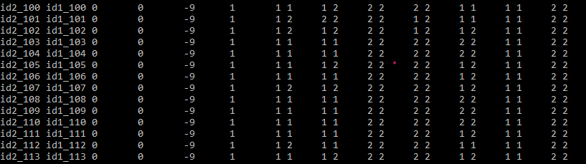
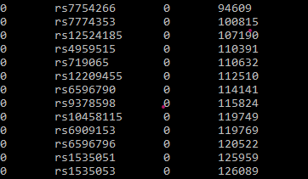
GTOOL
.ped file
.map file

Slide 8
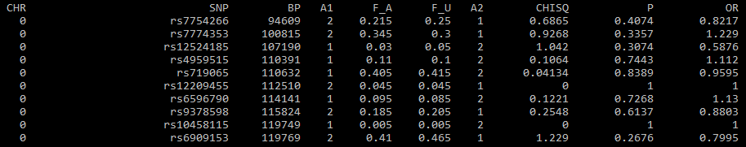
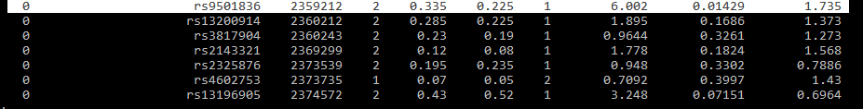
Then PLINK focus on the analysis of the phenotype data. ./plink --noweb --file ../joined --assoc --allow-no-sex --out Q .assoc file
PLINK

Slide 9
We then use the SNPTEST program, which is mainly a package for conducting correlation tests on SNPs.This tool downloads input files from hapgen2 (.gen and .sample) and creates a file that contains the results of a score test that fully explains the uncertainty in implicit genotypes.
SNPTEST

Slide 10
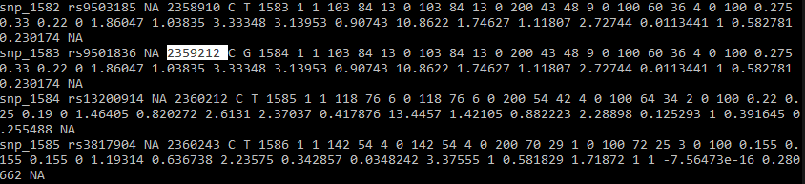
SNP

Slide 11
Τhe end, it is worth mentioning a hole in the summarythe genabel that uses the r package that is responsible for wide genome correlation analyzes.the genesis package provides methodology for estimating, drawing conclusions and calculating population and genealogical structure in genetic analysis.

